Slide 1
Requirements Engineering
Lecture 3
Ruzanna Chitchyan, Jon Bird, Pete Bennett
TAs: Mitch Lui, Craig Barnfield, Ollie Mayers, Kira Clements
Notes:
RC

Slide 2
Overview
What are requirements?
Stakeholder Identification
Functional and Non-Functional Requirements
Describe system behavior and capture it in a model with Use Case Model
Use Case Diagram
Use Case Specification
Requirements Quality
Notes:
Introduce the objectives for the module.

Slide 3
Requirements
System requirements specify a system, not in terms of system implementation, but in terms of user observation. Requirements record description of the system features and constraints.
Functional requirements specify user interactions with the system , they say what the system is supposed to do:
Statements of services the system should provide
How the system should react to particular inputs
How the system should behave in particular situations
May also state what the system should NOT do
Non-functional requirements specify other system properties, they say how the functional requirements are realised:
Constraints ON the services or functions offered by system
Often apply to whole system, not just individual features

Slide 4
Why do we need Requirements Engineering?

Slide 5
General Problems and Requirements Engineering
Inconsistent terminology: people express needs in their own words
Conflicting needs for the same system
People frequently don’t know what they want (or at least can't explain !)
Requirements change quite frequently
Relevant people/information may not be accessible

Slide 6



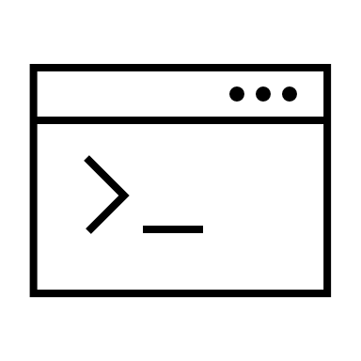

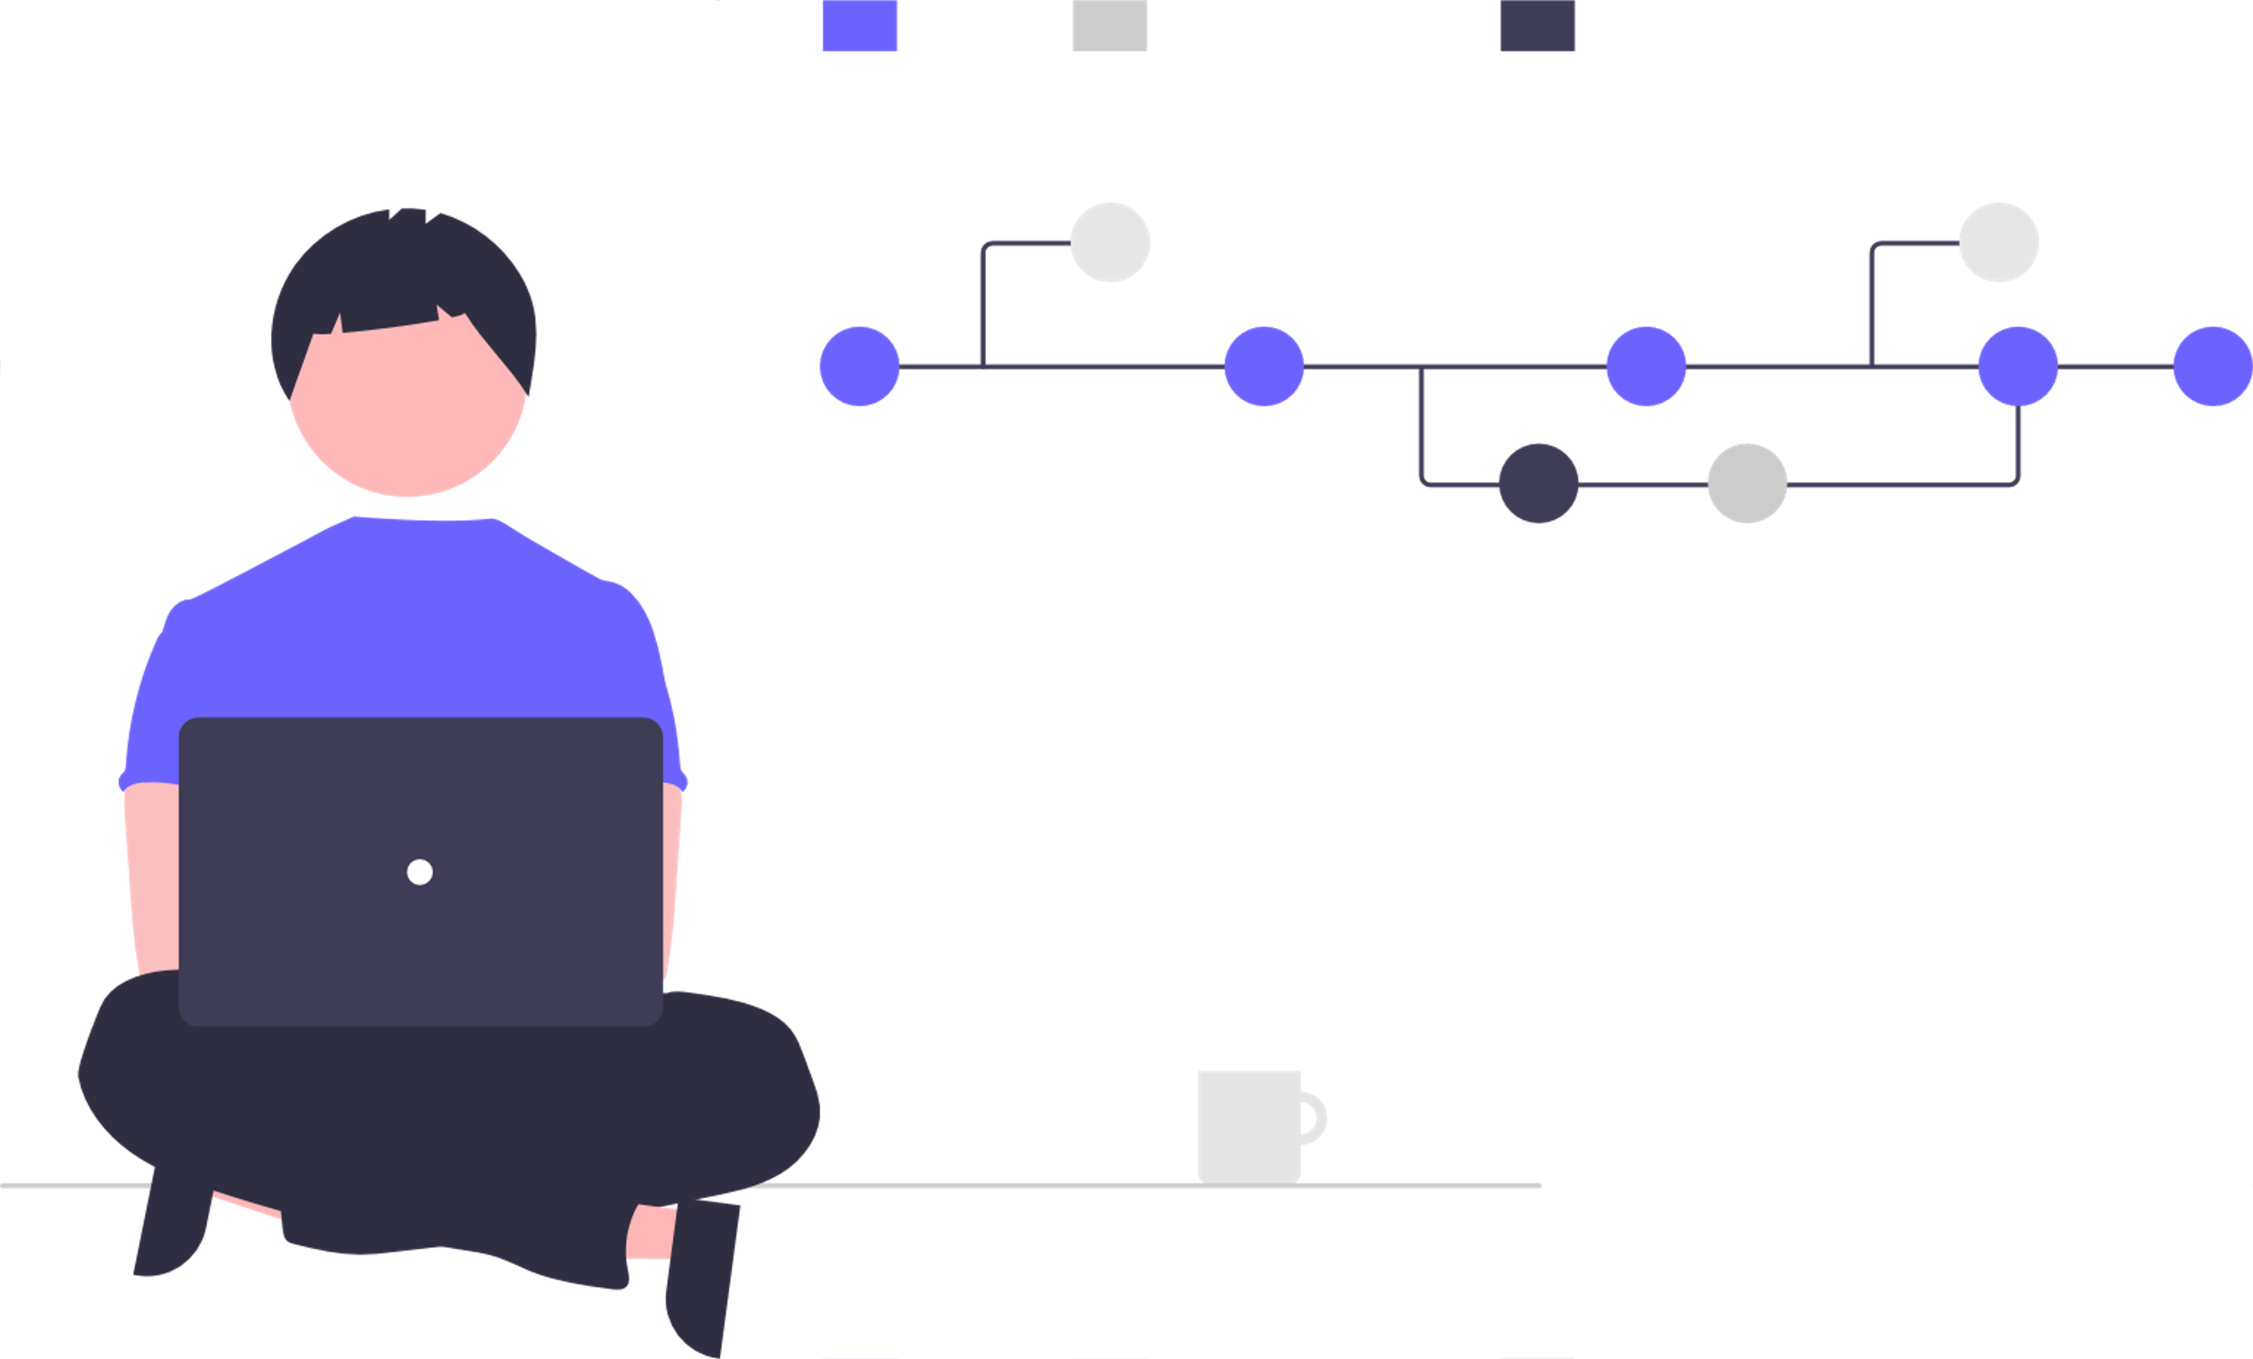
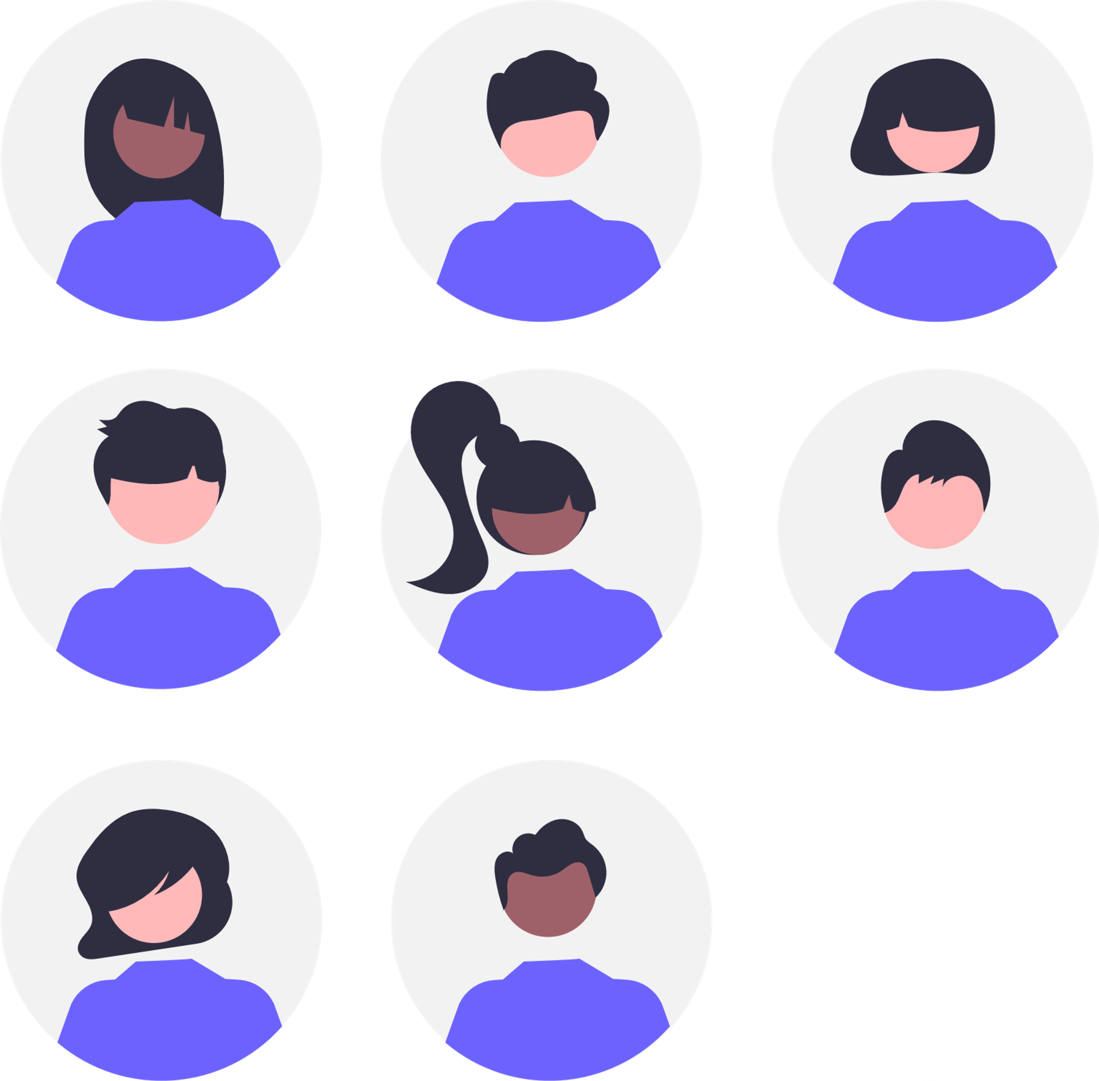

Requirements are communication mechanism
System
Administrator
write
read
advises
fix
Developers
Requirements
Software
compare
software
against
requirements
writes
Customers
Business Analyst
Tester
Notes:
Introduce the objectives for the module.

Slide 7
Requirements are instructions
On your own or in pairs
Follow some instructions to draw.
I'll then judge whether you followed the instructions correctly.
NOT your artistic skill!
Notes:
Introduce the objectives for the module.

Slide 8
Drawing Activity: 5 min.

Slide 9
Requirements are acceptance criteria
To be able to fairly assess whether the team have produced something that matches what you asked for, the thing that you asked for must be:
Unambiguous / Precise
Complete
Understandable / Clear
Notes:
Introduce the objectives for the module.

Slide 10
Analysing Requirements
Identify stakeholders involved with the system
Identify top-level user needs (e.g., as NFRs or ”user stories”)
Break down stories into individual steps / Refine requirements
Specify atomic requirements (e.g., for each step in user stories)
Let’s look at each of these stages in turn…

Slide 11
1. Identify Stakeholders

Slide 12
The Onion model
(Figure from I. Alexander’s book)

Slide 13
Stakeholders
Identification
Clients
Documentation, e.g., organisation chart
Templates (e.g., onion model)
Similar projects
Analysing the context of the project
Keeping in mind:
Surrogate stakeholders (e.g., legal, unavailable at present, mass product users)
Negative stakeholders

Slide 14
2. Identify top level needs/concerns

Slide 15
Identify “User Stories”
A popular way to record user needs…
As a < type of user >, I want to < some goal >
so that < some reason >.
As a student, I want to be able to register for a module, so that I can learn about topics of interest to me.
As a customer, I want to be able to pay for a university course, so that I can attend the lectures to get a degree.
As a customer, I want to have my data kept securely, so that my privacy is protected.

Slide 16
What Is System Behavior?
System behavior is how a system acts and reacts.
It comprises the actions and activities of a system.
System behavior is captured in use cases.
Use cases describe the interactions between the system and (parts of) its environment.
Notes:
Explain what is meant by “system behavior.” How do you capture system behavior?

Slide 17
What is a use-case model?
Describes the functional requirements of a system in terms of use cases
Links stakeholder needs to software requirements
Serves as a planning tool
Consists of actors and use cases
Notes:
We introduce the definition of a use- case model here in the module after we have explained use cases and actors because a use-case model consists of actors and use cases.

Slide 18
Capture a use-case model
A use-case model is comprised of:
Use-case diagrams (visual representation)
Use-case specifications (text representation)
Notes:
Point out that it takes relatively little effort to create the diagram; the main effort goes into writing the use cases.

Slide 19
Use-case diagram
Shows a set of use cases and actors and their relationships
Defines clear boundaries of a system
Identifies who or what interacts with the system
Summarizes the behavior of the system
Use-case diagram
The System
The System
Use case 1
Use case 1
Use case 1
Actor 1
Actor 1
Actor 1
Use case 2
Use case 2
Use case 2
Actor 2
Use case 3
Use case 3
Use case 3
Actor 3
Actor 3
Actor 3
Notes:
Many people write use cases, but do not create use-case diagrams. But, a picture is truly worth a thousand words. Encourage students to create use-case diagrams. Point out that they do not need a tool to create them: pencil and paper work well also.

Slide 20

What Are the Benefits of a Use-Case Model?
Communication
Identification
Testing
Use Case
Communication
Test plan
Identification
End User
Domain Expert
Users
Notes:
Yes, you are selling the concept of a use-case model here. Many of your students may not immediately recognize the need for the use-case model because it is so simple. This slide is intended to bring out some of the problems that this model resolves. Feel free to add your own experiences here.
Talking about this slide, mention:
Communication with the end users and domain experts
Provides buy-in at an early stage of system development
Insures a mutual understanding of the requirements
Identification of system users and what the system should do
Considers the requirements for the system interfaces
Verification that all requirements have been captured
The development team understands the requirements

Slide 21
Major Concepts in Use-Case Modeling
An actor represents anything that interacts with the system.
A use case describes a sequence of events, performed by the system, that yields an observable result of value to a particular actor.
Actor
Use Case
Notes:
Introduce the two major concepts in use-case modeling.
Do not go into great detail explaining what an actor and use case are in this slide. Detailed actor and use-case slides are coming up soon.

Slide 22
What Is an Actor?
Actors represent roles a user of the system can play.
They can represent a human, a machine, or another system.
They can actively interchange information with the system.
They can be a giver of information.
They can be a passive recipient of information.
Actors are not part of the system.
Actors are EXTERNAL.
Actor
Notes:
Explain the concept of actors to the students. Remember, this is new to them.
Be sure that the class understands that an actor is NOT JUST A PERSON.
An actor is anything that interacts with the system and is external to the system.
Illustrate this concept by using the example of an ATM machine.
Ask the class to identify some potential actors. Answers may include: bank customer, maintenance worker, bank teller, bank system, credit card system, and so on.
If you aren’t allowed to change it then it is an actor.

Slide 23
What Is a Use Case?
Defines a set of use-case instances, where each instance is a sequence of actions a system performs that yields an observable result of value to a particular actor.
A use case models a dialogue between one or more actors and the system
A use case describes the actions the system takes to deliver something of value to the actor
Use Case
Notes:
Explain the concept of a use case to the students. This material is also new to them.
Use cases focus on WHAT the system does, not HOW it does it.
A use case has a set of properties that includes a brief description, flow of events, special requirements, activity diagrams, and so on. These are discussed in more detail later in this module.
Use cases are enclosed in the use-case model artifact. That is, use cases are properties of the use-case model.

Slide 24
Use Cases and Actors
·
Use Case
Association
Actor
Notes:
Show the relationship between use cases and actors.
A use case can initiate communication with an actor. Usually, this occurs with a non-human actor.
The <<communicate>> association stereotype was valid for the UML1 example profiles UML Profile for Software Development Process, which is based on the Unified Process for software engineering, and the UML Profile for Business Modeling.
Since an association is the only valid relationship that can exist between actors and use cases, UML 2 has dropped the stereotype.

Slide 25
Actors and the system boundary
Determine what the system boundary is
Everything beyond the boundary that interacts with the system is an instance of an actor
System boundary?
Is the Accounts System an actor or part of the system?
Financial
Analyst
?
?
Course Registration
System
Accounts
System
Financial
Analyst

Slide 26
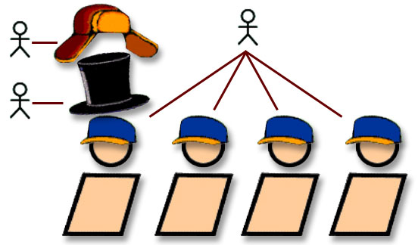
Actors and roles
An actor represents a role that a human, hardware device, or another system can plan in relation to the system.

Slide 27
Actors
Enroll for a course
Louis acts as a student
Student
Prepare for examination
Elen acts as a student
Deposit funds

Slide 28
Actors
Louis acts as a student
Enroll for a Course
Student
Prepare for Examination
Louis acts as a customer
customer
Deposit funds

Slide 29
How Would You Read This Diagram?
View Report Card
Course Catalog
Maintain Professor
Information
Register for Courses
Student
Login
Maintain Student
Information
Registrar
Select Courses to
Teach
Close Registration
Professor
Submit Grades
Billing System
Notes:
In this slide, give students a chance to read a use-case diagram.
Answers to student notes:
1. Student can perform: View Report Card, Register For Courses, and Login. A Professor can: Login, Select Courses to Teach, and Submit Grades. The Course Catalog is involved in: Register for Courses and Select Courses to Teach.
Disclaimer: Login is a controversial use case. The goal of this course is not to determine when/how/why one should use the Login use case, it is part of the Mastering Object Oriented Analysis and Design with UML curriculum so that instructors can have a short use case to demonstrate exercises. It is only here for instructional purposes.
2. Charlie can: View Report Card, Register for Courses, Login, Select Courses to Teach, and Submit Grades.
3. This is a Course Registration System.
4.The Professor initiates the Select Courses to Teach and the Course Catalog is a participant; the Registrar initiates the Close Registration and the Billing System is a participant.
5. Of course, this is a trick question. You can’t make that assumption from looking at this model. It isn’t intended to show order.

Slide 30
Modelling with Use Cases
Generalization between Use Cases means that the child is a more specific than the parent; the child inherits all attributes and associations of the parent, but may add new features
Check Balance
Check Balance by Computer

Slide 31
Structuring Use Case Diagrams
<<include>>
Check Balance
Identification
Bank Customer
Check Balance by Computer
Computer Bank Customer

Slide 32
Use Case Diagram: Structuring
<<include>>
Check Balance
Identification
Bank Customer
Check Balance by Computer
Computer Bank Customer

Slide 33
Use Cases
Specifies how the behaviour of the extension use cases e can be inserted into the behaviour of the base use case b.
e is optional.
e
<<extend>>
b
Extend ralationship
Specifies how the behaviour of the included Use Case p contributes to the behaviour of the base use case b.
b
<<include>>
p
Include relationship

Slide 34
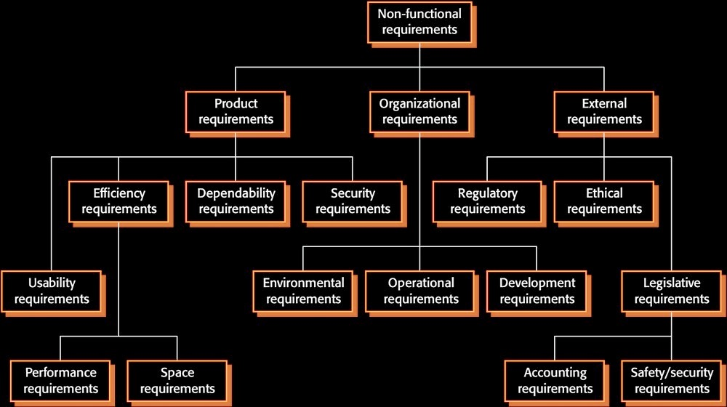
But also: Non-functional Requirements

Slide 35
3. Break down stories into individual steps / Refine requirements

Slide 36
Use-case specification
A requirements document that contains the text of a use case, including:
A description of the flow of events describing the interaction between actors and the system
Other information, such as:
Preconditions
Postconditions
Special requirements
Key scenarios
Subflows
Use-case specification
Notes:
Point out to the students that all these terms will be explained later in the course.

Slide 37
Outline each use case
An outline captures use case steps in short sentences, organized sequentially
Use Case Name
Brief Description
Basic Flow
1. First step
2. Second step
3. Third step
Alternative Flows
Alternative flow 1
Alternative flow 2
Alternative flow 3
Structure the basic flow into steps
Number and name the steps
Identify
alternative
flows
Notes:
Structure the flow into steps with either bullets or numbers.
Review the basic concepts for developing a use-case outline.
See Student Notes.

Slide 38
Flows of events (basic and alternative)
A flow is a sequence of steps
One basic flow
Successful scenario from start to finish
Many alternative flows
Regular variants
Odd cases
Exceptional (error) flows
Notes:
This slide adds more depth about basic and alternative flows. Review some reasons to have alternative flows of events.
Ask: “Why not just put all the descriptions of all the options into the basic flow of events?”
Answer: Because it would be hard to read, like reading a flowchart in text form.
The basic flow of events should be relatively short and very easy to read (like a single story). Typically, most of the other descriptions are located in alternative flows.
A short example may help to illustrate the different kinds of alternative flows (see Student Notes).

Slide 39
What is a use-case scenario?
An instance of a use case
An ordered set of actions from the start of a use case to one of its end points
Flow
Scenario
Note: This diagram illustrates only some of the possible scenarios based on the flows.
Notes:
We talk about scenarios here in the course because sometimes when people find use cases they find use case scenarios first and end up merging these scenarios into a use case.

Slide 40
Checkpoints for use cases
Each use case is independent of the others
No use cases have very similar behaviors or flows of events
No part of the flow of events has already been modeled as another use case

Slide 41
4. Specify atomic requirements (e.g., for each step in user stories)
Not detailed in this course, e.g.:
Structured language
Formal methods

Slide 42
Quality Attributes of Requirements
Consistency: Are there conflicts between requirements ?
Completeness: Have all features been included ?
Comprehendability: Can the requirement be understood ?
Traceability: Is the origin of requirement clearly recorded ?
Realism: Can the requirements be implemented given available resources and technology ?
Verifiability: Can requirements be “ticked off” ?

Slide 43
Verifiability of Requirements
We should ensure that requirements are verifiable
No point specifying something that can't be "ticked off"
For example, the following is an unverifiable "objective":
The system must be easy to use by waiting staff and should be organised so that user errors are minimised.
In comparison, the following is a testable requirement:
Waiting staff shall be able to use all system functions after four hours of training. After this training, the average number of errors made by experienced users shall not exceed two per hour of system use.

Slide 44
Requirements Elicitation Techniques
Interviews
Observations
Surveys
Current documentation
Similar products and solutions
Co-design
Prototyping
…

Slide 45
Review
What are models for?
What is system behavior?
What is an actor?
A use case?
What is a role?
How do we know if our requirements are of good quality?
Notes:
A. System behavior is how a system acts and reacts. It is an outwardly visible and testable activity of a system.
B. A use-case model describes a system’s functional requirements in terms of use cases. It is used to communicate with the end users and the domain experts. A benefit includes buy-in at an early stage of system development.
C. An actor is anything that exchanges data with the system and is external to the system. A use case is a sequence of actions a system performs that yields an observable result of value to a particular actor.
D. An activity diagram in the use-case model can be used to capture the activities in a use case. It is essentially a flow chart, showing flow of control from activity to activity.

